Slide 1
Formulating a New Real Denial Rate of Mortgage Applications
Computer Science Senior Paper Preparation
Khawm Mung

Slide 2


Overview and Motivation
Real Denial Rate (RDR)
Traditional (Observed) Denial Rate is crude and ignores many variables
RDR is an effective tool to better understand housing market trends
Existing RDR uses proprietary data
Formulate New (better) RDR

Slide 3
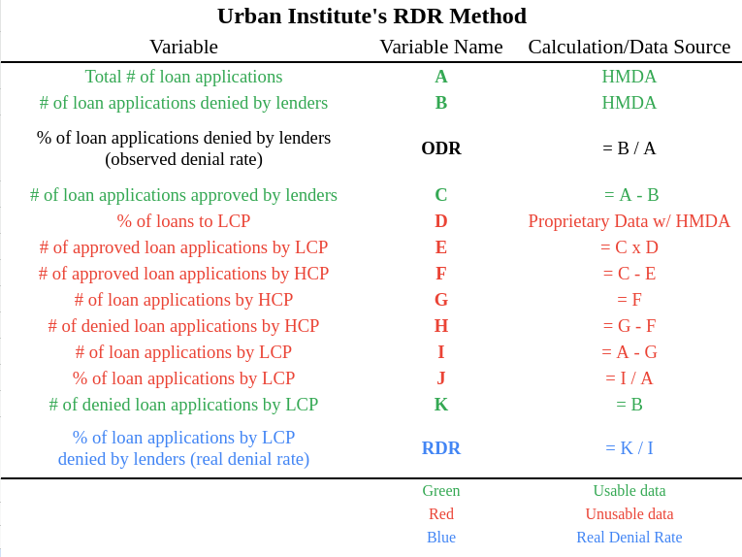
Preliminary Research
Urban Institute’s RDR = K / I
K = # of denied loan applications by Low Credit Profiles
I = # of loan applications by Low Credit Profiles
Rely on proprietary data to determine the credit profile of borrowers

Slide 4
Proposed Approach
Parameters
Total # of mortgage applications
Total # of denied applications
Denial reasons
Debt-to-income ratio
Income
Loan amount
Mortgage rates
Aim is to use publicly available data
Home Mortgage Disclosure Act (HMDA)
Historic Mortgage Rates
Develop a predictor model for mortgage acceptance

Slide 5
Thank You

